Slide 1

Convolutional Neural Networks
Convolutions over volumes
deeplearning.ai

Slide 2
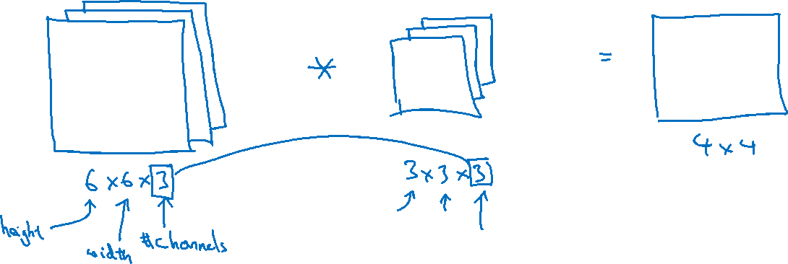
Convolutions on RGB images

Slide 3


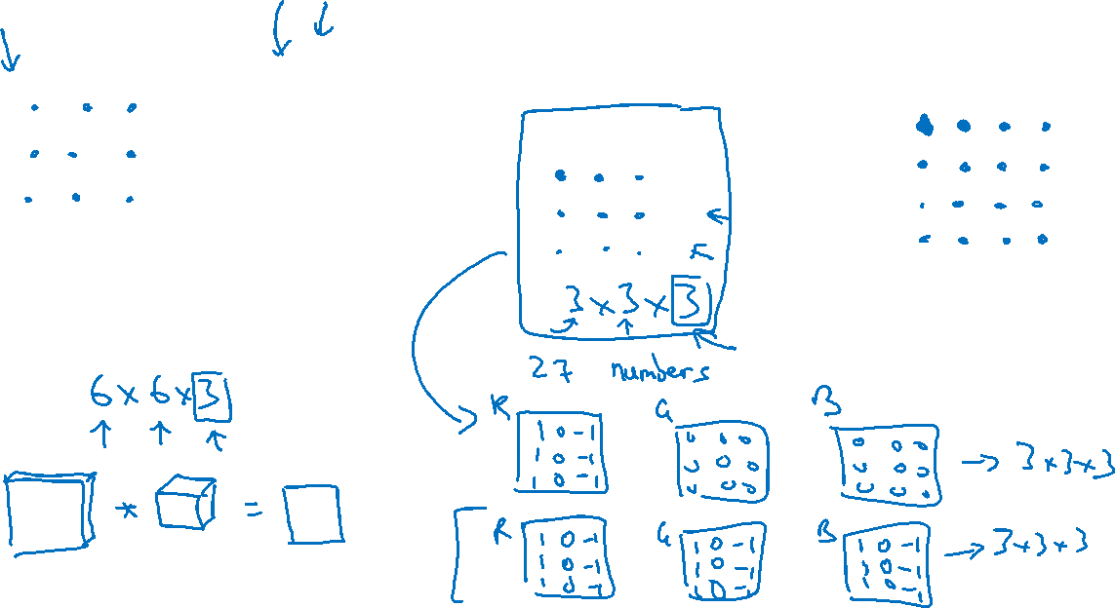
Convolutions on RGB image
$$∗$$
$$=$$
4 x 4

Slide 4





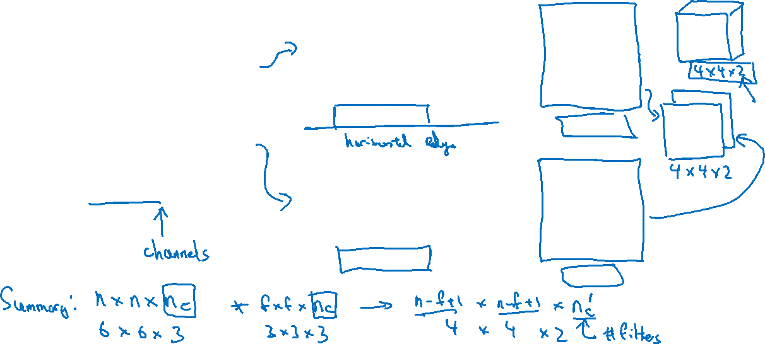
Multiple filters
$$∗$$
$$=$$
3 x 3 x 3
4 x 4
6 x 6 x 3
$$∗$$
$$=$$
3 x 3 x 3
4 x 4

